Slide 1
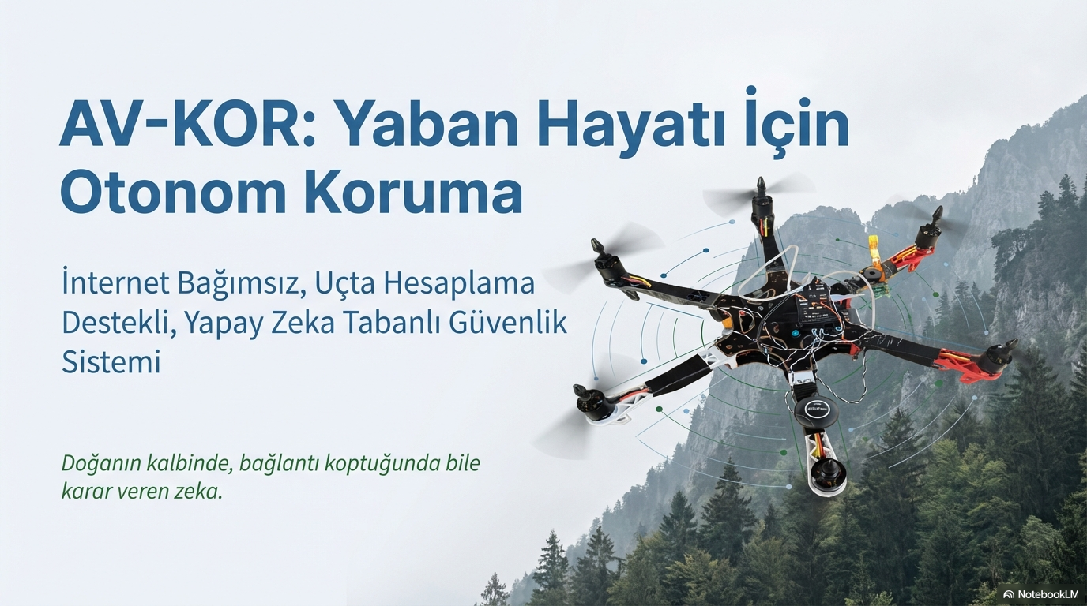




Internet-Independent, Edge Computing Supported Artificial Intelligence-Based Security System
““Intelligence at the heart of nature that makes decisions even when disconnected.”
Yiğit KURT
Metin Oktay SUZGENLI

Slide 2

Project Purpose:
The purpose of this project; national pOur aim is to develop an autonomous UAV patrol system supported by artificial intelligence that can detect unauthorized entries and biosmuggling activities in large, steep areas such as parks and protected areas where internet infrastructure is limited. The system performs analysis on the drone with end-to-end calculations, allowing authorized/unauthorized distinction. While it instantly reports violations and transmits live images when there is an internet connection, it continues to carry out all processes autonomously offline in cases where there is no connection.
2

Slide 3

Project Purpose:
The system is activated only when a violation is detected and records the image of the incident locally, along with GPS location and time information, using the "Black Box" logic; Thus, data security is protected and unnecessary data load is not created. In addition, AV-KOR aims to provide a continuous, safe and sustainable control mechanism in protected areas by reducing the delay, high cost and margin of error encountered in manpower-based monitoring systems.
3

Slide 4
Problem:
The main control methods currently used in wildlife conservation areas are; It is based on manned patrols and camera trap systems. However, these approaches are insufficient to provide continuous and effective control in protected areas with large surface areas, steep terrain and difficult access. It is not possible for a limited number of forest conservation officers to work in the field 24/7 due to both physical risks and high operational costs. Manpower-based inspections can often be carried out at certain time intervals and on limited routes, which creates serious inspection gaps in large areas.
4

Slide 5
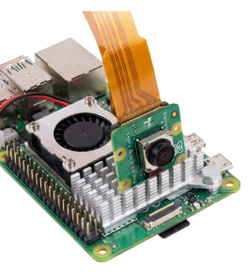
Solution Step 1:
The AV-KOR system works completely offline with its edge computing architecture in steep terrain without internet. The imaging and preprocessing process of the system can be summarized as follows:
• Hardware: Raspberry Pi Camera Module 3 (NoIR) was preferred for twilight and day/night vision; This unit is integrated into the Raspberry Pi 5 (8GB RAM) embedded system for uninterrupted data flow.
• Software and Pre-Processing: Raw images using OpenCV library; To reduce processing load, it is converted to grayscale, resized for AI models, and visualized in the interface at the time of detection.
• Performance and Access: The system runs at an average speed of 11.6 FPS per second without the need for a cloud connection; In cases where an internet connection is available, it allows instant data monitoring via remote access.
5

Slide 6
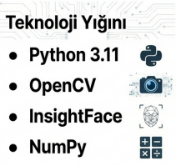
Solution Step 2:
Biometric verification process in the AV-KOR system; Face detection is achieved through an integrated flow consisting of feature extraction and similarity analysis.First of all, automatic face detection is performed in camera images, and when the face is detected, the image data is converted into a vector representation (embedding) using the InsightFace library and the buffalo_1 model.The resulting face vector is compared with authorized personnel vectors in the local SQLite database on the drone using the Cosine Similarity algorithm. As a result of the optimizations, a threshold value of 0.5 was taken as basis in order to distinguish between authorized and unauthorized in a stable manner. This entire process is completed in an average of 420 ms, allowing the system to make real-time decisions.
6

Slide 7
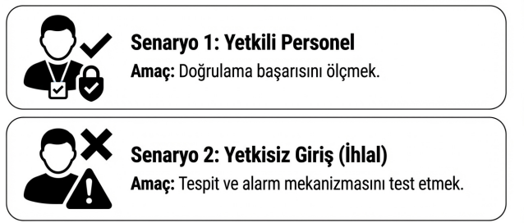

Solution Step 3:
Even if the biometric match is achieved, the AV-KOR system produces the final decision by querying the person's "License Validity Date" and "Territorial Authority" data through the local SQLite database. This decision mechanism and subsequent intervention steps work as follows:
• Classification and Intervention:
◦ Friend (Authorized): If the person meets all the criteria, information is given with a green frame on the interface and the transaction is processed into the system as "authorized access".
◦ Threat (Violation): If authorization cannot be verified, the Breach Protocol comes into play. System; It receives GPS location and time data, saves the photo and log record of the moment of violation as digital evidence in the "Black Box" unit and triggers an audio/visual alarm via buzzer.
7

Slide 8
Method:
During the research process, the experimental model, one of the quantitative research approaches, was preferred in order to reveal the cause-effect relationships between the variables in the most clear way. Within the framework of this model, the effect of the determined parameters on the project's outputs was observed in a controlled environment and the obtained data was supported by statistical analysis.
8

Slide 9
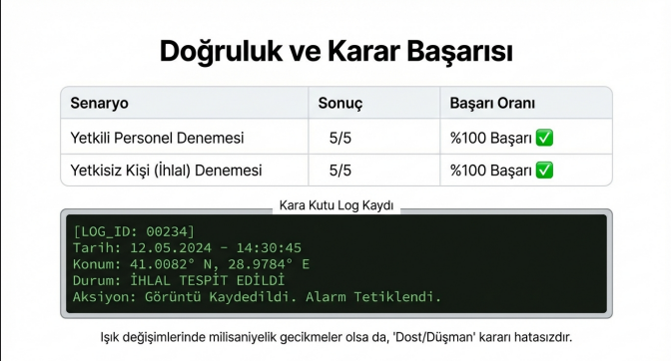
Findings 1:
Scenario-Based Detection and Verification Performance The system's discrimination ability was tested a total of 10 times on 5 authorized and 5 unauthorized subjects. A 100% accuracy rate was achieved in all tests performed.
• Unauthorized Person Detection: "Violation Protocol" worked without any problems when persons who were not registered in the database were detected; An audible warning was given with a buzzer and the images were recorded on the local unit along with the GPS tag.
• Authorized Personnel Verification: When identified personnel were detected, the system successfully matched the biometric data and instantly displayed the personnel's license/regional authority information on the interface.
9

Slide 10
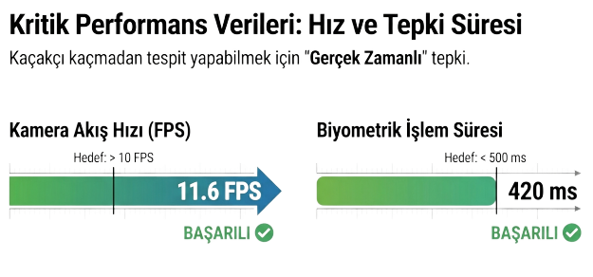
Findings 2:
System Performance (Speed ​​and Latency) In the analyzes performed on the embedded system using the edge computing method, the initial targets of the project were exceeded:
• Processing Speed: The camera flow rate was measured as 11.6 FPS per second, and the targeted 10 FPS threshold was exceeded.
• Algorithmic Inference Time: The average time from image acquisition to identification was recorded as 420 ms. This time remained below the target value of 500 ms, proving the real-time control capability of the system.
10

Slide 11
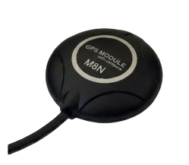
Findings 3:
Subjectm Accuracy and GPS Stability In open field tests, the GPS module accurately labeled event locations in Google Maps format. Especially in the trials under camellias simulating tree density, maintaining the satellite connection and continuing to produce location data despite the closure of the superstructure showed that the system can function in forested areas.
11

Slide 12
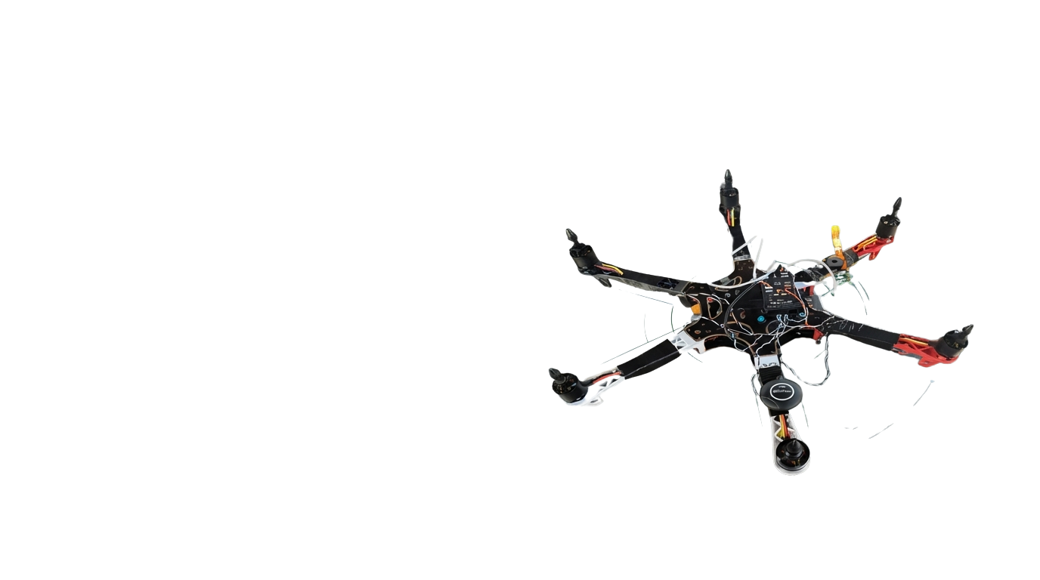
Why Hexacopter?
Stability and Vibration Control: In artificial intelligence-supported image processing, it is aimed to minimize vibration and ensure high stability for the clarity of the data.
• Safety and Redundancy: Unlike quadcopter systems, the ability to land safely even in possible engine failures has been chosen as a safety measure for operations in steep terrain.
• Resistance and Carrying Capacity: The high wind resistance offered by the 6-arm structure and the high load capacity that can stably carry heavy hardware such as Raspberry Pi 5 are the reasons for preference.
In summary; This body structure was used to maintain image quality, ensure hardware safety and achieve stable flight under heavy payload.
12

Slide 13
InsightFace:
InsightFace is the biometric verification "brain" of the AV-KOR system and is a library considered SOTA (the cutting edge of technology) in the literature. Its main functions in the project are as follows:
• Feature Extraction: It analyzes facial pixels with the buffalo_l model and converts them into mathematical vectors (embedding).
• Biometric Authentication: Authenticates by comparing these created vectors with records in the local SQLite database.
• Edge Computing Efficiency: Performs "algorithmic inference" on Raspberry Pi 5 in a short time of 420 ms, without the need for the Internet.
13

Slide 14
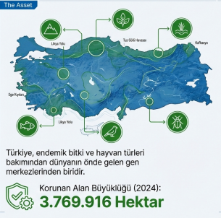
Below AV-KOR? - 1
Geographical Difficulties and Insufficient Control
The total surface area of ​​protected areas in Türkiye has reached approximately 3.8 million hectares (37,700 km²). It is physically impossible to effectively monitor these huge and steep lands 24/7 with a limited number of forest conservation officers. AV-KOR closes this gap by quickly reaching these areas that people have difficulty in accessing and scanning from a bird's eye view.
14

Slide 15
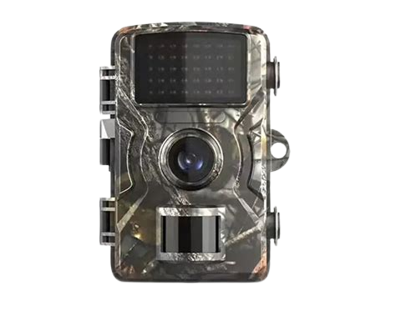
Below AV-KOR? - 2
"Instant" Intervention, Not "After the Incident";
Currently used camera traps are passive (reactive) systems, providing data only after the event is over. AV-KOR, on the other hand, offers a proactive control mechanism that enables real-time detection and intervention "at the time of the incident".
15

Slide 16

Below AV-KOR? - 3
Internet and Communication Independence (Edge Computing)
GSM or Wi-Fi infrastructure is generally not available in deep forests and steep terrain. AV-KOR performs all analyzes (face detection, verification, decision-making) on ​​the Raspberry Pi 5-based embedded system on the drone, that is, with the edge computing architecture. In this way, it can work even in places where there is no internet, without the need to send data to the cloud or the center.
16

Slide 17
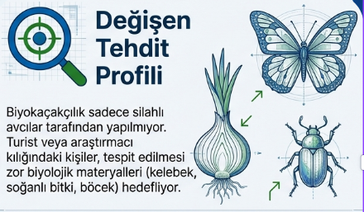
Below AV-KOR? - 4
Fighting Biosmuggling;
Biosmugglers are not always armed hunters, sometimes they are people who collect endemic plants, butterflies or insects under the guise of tourists or researchers. AV-KOR helps protect biodiversity by detecting any unauthorized person entering the prohibited area, even if the person does not have a weapon.
17

Slide 18
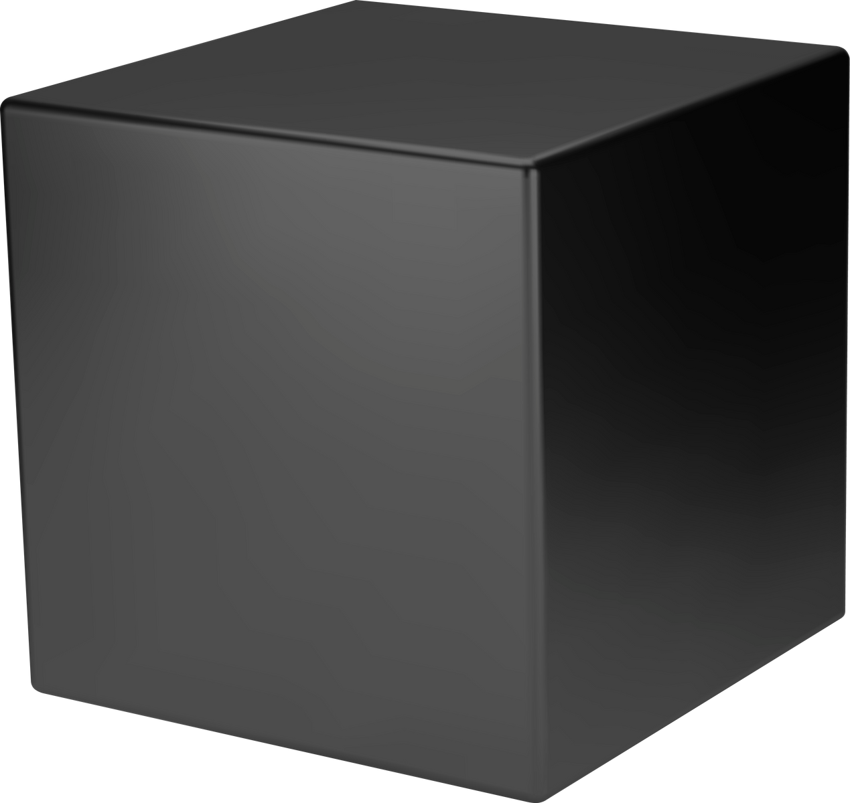
Below AV-KOR? - 5
Digital Evidence and "Black Box" System;
The system not only sounds an alarm when it detects a violation; It also records the GPS location of the incident, its time stamp, and a photograph of the moment of the breach in the local "Black Box" unit. This data serves as digital evidence to prove illegal activities.
18

Slide 19
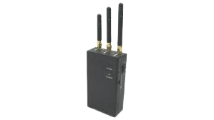
Below AV-KOR? - 6
Security and Electronic Warfare Resistance;
Since it processes image data on the device instead of transferring it to the center, it has a decision architecture that is not affected by external interventions such as signal tracking or jamming and communication interruptions. In addition, closed-circuit processing of data on the drone facilitates compliance with KVKK and ethical principles.
19

Slide 20
Below AV-KOR? - 7
Operational Efficiency and Low Cost;
Manpower-based patrols are both costly and have a high margin of error (fatigue, distraction, etc.). An autonomous UAV system offers a sustainable security model by reducing these risks and costs.
20

Slide 21
Below AV-KOR? - 8
Authorized and Threat Separation (Prevention of False Alarms);
Existing security-oriented UAVs in the literature generally only detect "human presence", which causes false alarms every time on-duty personnel pass by. By performing biometric verification (facial recognition), AV-KOR distinguishes whether the detected person is a personnel authorized to be in the field or a threat.
21

Slide 22
Suggestions:
• Optical Zoom Support: Required to prevent loss of detail beyond 4-5 meters and to collect data from a safe distance.
• Thermal Sensors: Should be added to the hybrid architecture to detect live creatures from a long distance at night.
• Spot Lighting: Creates an environment that allows the optical camera to perform biometric verification in low light.
• LiDAR Integration: Provides autonomous avoidance of physical obstacles by instant mapping in densely forested forests.
• Different Usage Areas: This drone is not only in the field of nature conservation; It can also be used effectively in detecting natural disasters such as earthquakes and forest fires.
• Swarm UAV Architecture: Allows coordinated scanning of very large national parks by overcoming battery and flight time constraints.
• Data Encryption: "Black Box" records must be protected with encrypted algorithms in accordance with KVKK and ethical standards.
• Advanced Lenses: Prevents face detection speed from decreasing in sudden light changes and cloud transitions.
• Depth Cameras: Increases the safety of autonomous navigation in steep terrain where the GPS signal is weak.
• Internet Connection: The drone provides instant access to its data if there is an internet connection. Although there is currently no internal internet infrastructure, real-time data tracking will be possible from anywhere in the world when this feature is added.
22

Slide 23
FOR LISTENING TO US THANKS
brave wolf
Metin Oktay SUZGENLI

